Slide 1
Heart Sensor project Ranye Mclendon, Anya Ellis, Jailyn Battle, Alvin Nnabue, Funmi Adediwura, Precious Isidahomen date: 6/27/2019
Interim project report
Reu/RET Site: Norfolk state university
sCR² REU/RET, Summer 2019

Slide 2


Project goals
The end goal of the project is to use the Piezoelectric sensor to measure heart rate from the mechanical disturbance in a heartbeat.

Slide 3
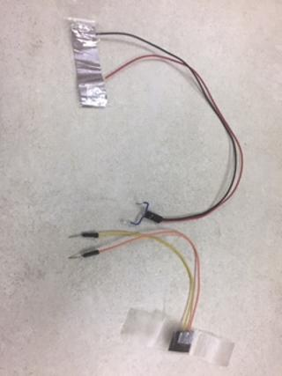
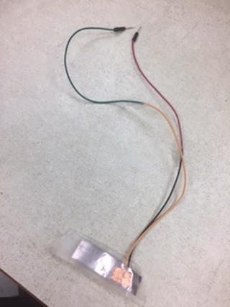
Progress
Accomplishments
Created a voltage divider circuit to attempt measuring the heart rate
Created miniature sensors using Piezoelectric film, wires, and copper or aluminum tape
Challenges
Finding an ideal place to attach the heart sensor ( wrist, arm, chest )
Filtering out the background noise being picked up by the sensors

